Slide 1
STERLING
E-COMMERCE PROJECT

Slide 2

PROBLEM TASK SUMMARY
The key objectives of this project are;
Extracting Customer Insights:
Understanding customer needs, preferences, and behaviors from their data.
Identifying Trends:
Analyzing customer data to uncover patterns and trends.
Product Optimization and Operational Efficiency:
Leveraging customer data to recommend product optimizations and enhance operational efficiency.
Enhancing Customer Experience:
Utilizing customer data to gain insights into Sterling’s customer experience and make enhancement recommendations.

Slide 3
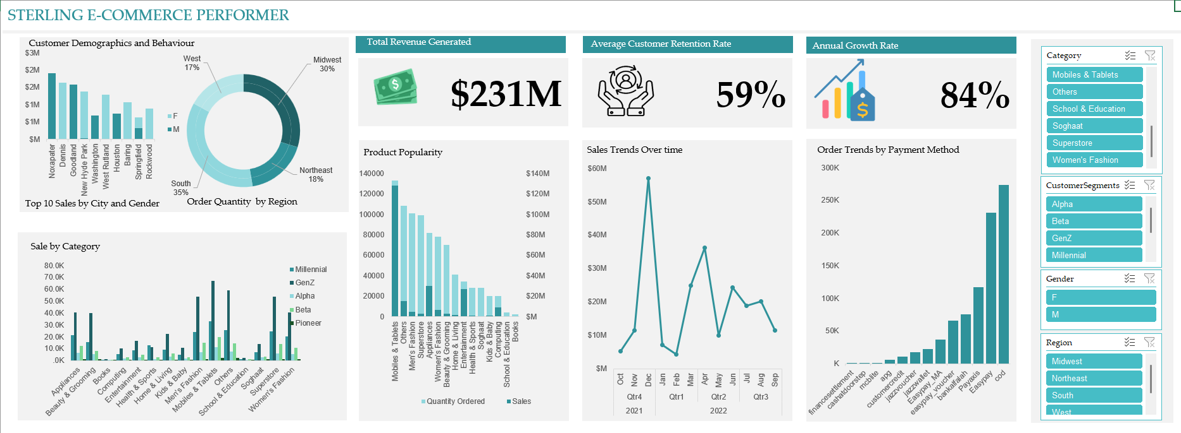
STERLING E-COMMERCE CAPSTONE RESULTS
Notes:
Customer Demographics:
Location: The highest number of customers are from urban areas, specifically major cities like Noxapater, Dennis, Goodland, and New Hyde Park.
Gender Patterns:
All purchases from Noxapater were made by male customers.
All purchases from Dennis were made by female customers.
Similar gender-specific purchasing patterns are seen in cities like Goodland, Washington, and Houston.
There is a more balanced gender distribution of purchases in Springfield.
Customer Behavior:
Purchase Frequency: Most customers make purchases once a month, with a noticeable increase towards the end of each quarter.
Preferred Categories: Top categories include mobiles and tablets, others, men’s fashion, superstore, and electronics.
Preferred Order Payment Method:
Customers prefer to close their orders through COD (Cash on Delivery), Easypay, and Payaxis channels.
Financial settlement and Cashatdoorstep payment channels appear to be redundant.
Sales Trends:
Seasonal Peaks: Highest sales are observed during the holiday season (December), followed by a slow pickup of sales from Q4 2021 through Q1 2022, likely due to the after-holiday sales effect.
Product Performance:
Best-Selling Products: Include mobiles and tablets, appliances, entertainment, and others.
Worst-Selling Products: School & education categories, including books, perform poorly, contributing income in thousands compared to the millions brought in by other categories.
Customer Categories:
Gen Z customers (who started buying from the company since 2010) dominate product sales categories by over 50%.
Alpha customers (1978-1993) and Beta customers (1994-2001) contribute less to product sales.
Customer Experience:
The average customer retention rate is 59%, indicating a slightly above-average rate of converting first-time customers to loyal customers.

Slide 4
KEY RECOMMENDATIONS
CUSTOMER INSIGHT:
Develop detailed customer profiles and use the available data to introduce loyalty cards& promotions to excite customers and aid customer retention. Similarly, schemes like customer lifetime awards may help long-time customers.
2. PRODUCT OPTIMIZATION:
Adjust product offerings based on customer demand and ensure popular products like Mobiles and tablet, Others, Men’s fashion, Superstore, Electronic are well-stocked toward the end of each quarter to avoid out-of-stock issues which may arise.
3. OPERATIONAL EFFICIENCY:
Streamline to supply chain operations to phase out poor product categories such as School& Education, Books and also phase out COD and finance settlement order payment options to reduce costs and improve customer service.

